Slide 1
“Your Project Here”
A quick guide to making PowerPoint work for you!

Slide 2
“Open with a strong visual and/or quote.”
And take this opportunity to engage with your audience!

Slide 3
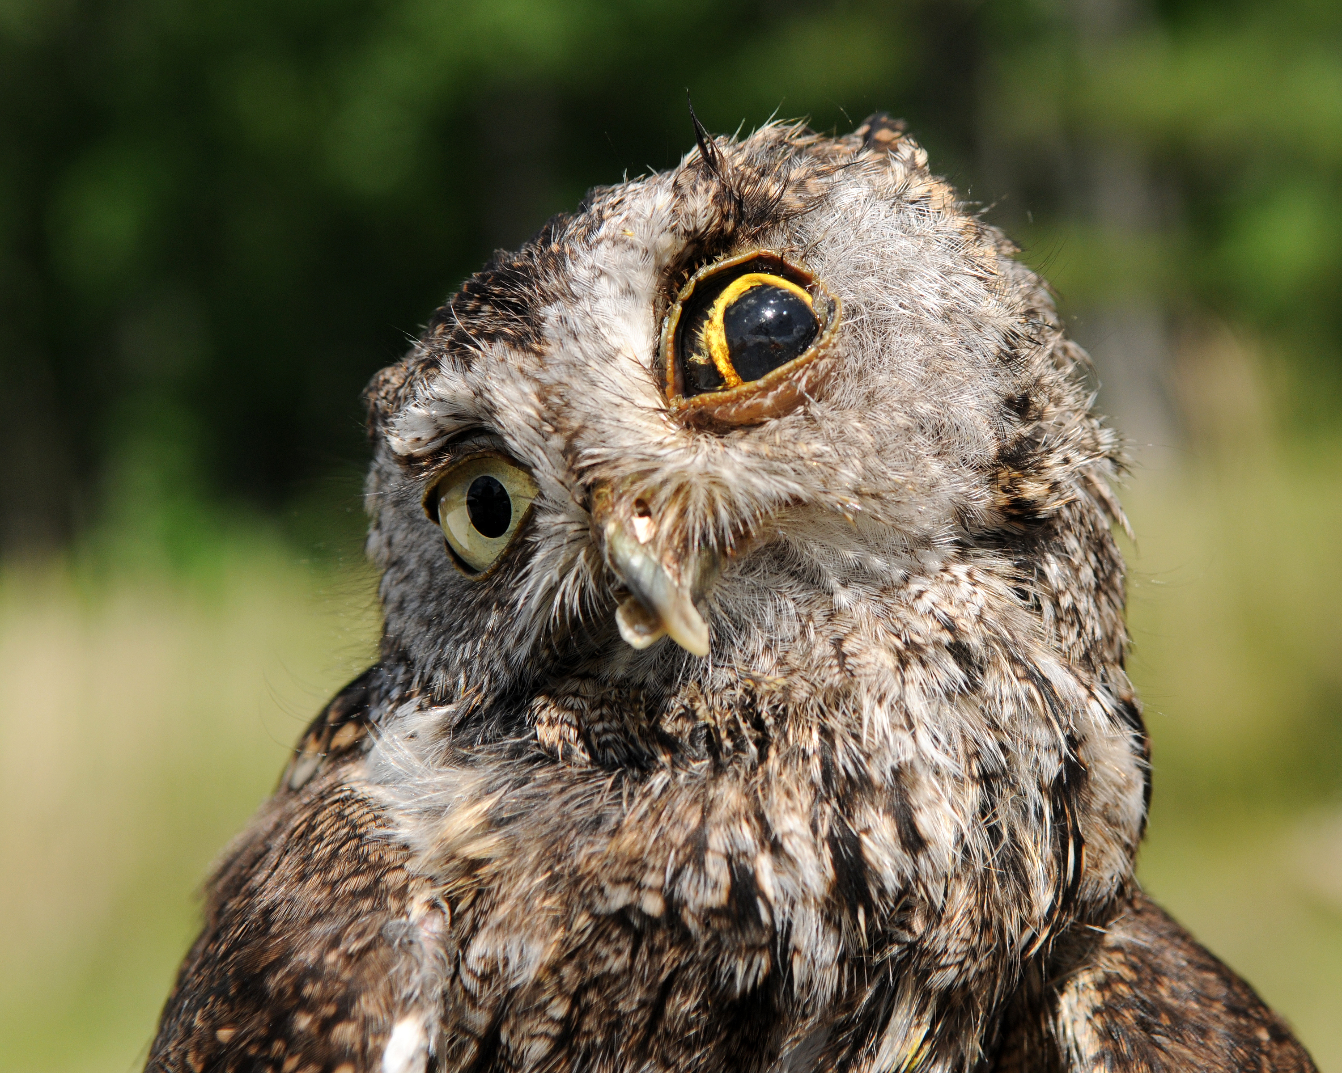
We want to know…
About You!
Who you are
Something interesting about you
What you’re passionate about
Why you’re giving this presentation
Notes:
Try to establish a rapport with your audience by balancing personal details with relevance. For example, you might be passionate about coin collecting, but unless you’re giving a talk the local chapter of the American Numismatic Society, that may not be relevant to the presentation (<-----See what we did there? Did you even know the word “numismatic” before today?)

Slide 4
Tell Us About the Project
Do
Don’t
Provide key information
Include visuals
Let people ask questions
Use consistent fonts
Overload a slide with info
Read directly from the slides
Use distracting transitions
Forget to proof your work
Notes:
Use the slides as a prompt, not a crutch! You can put additional specifics you might need help remembering here in the notes section. Only you will be able to see it while in slideshow mode.

Slide 5
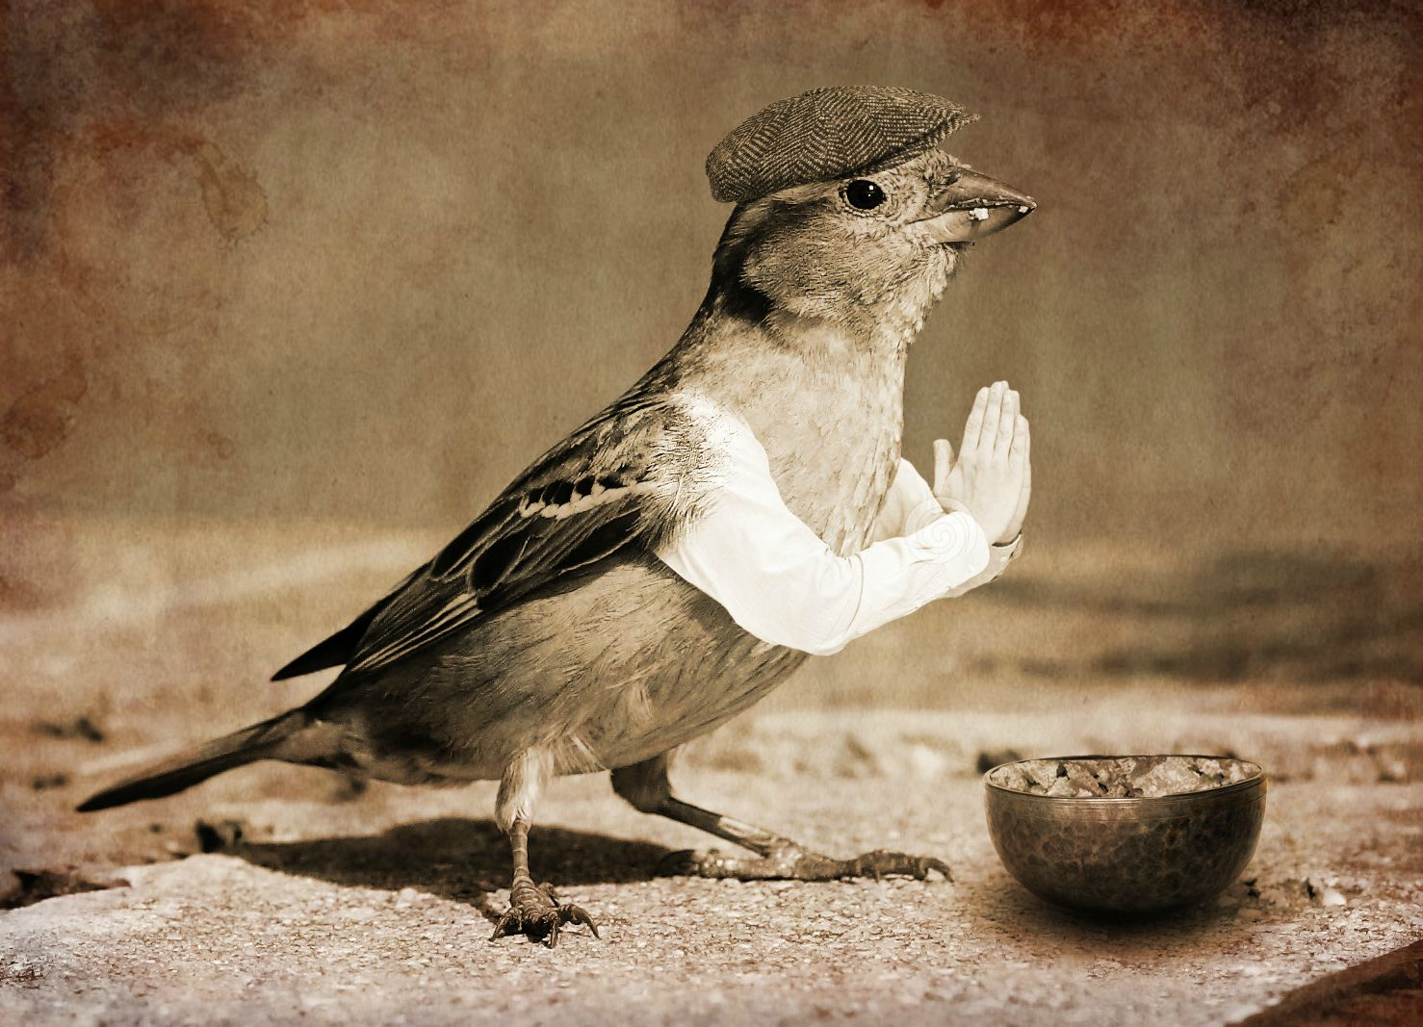
Give us more information!
“Please, sir, I want some more!”
Important Concepts
Challenges
Standout Moments
Next Steps
Image Source: https://imgur.com/r/birdswitharms/Dha6uMr
Notes:
The number of slides varies (we suggest no more than 15-20) but remember -- Use the slides as a prompt, not a crutch! You can put additional specifics you might need help remembering here in the notes section. Only you will be able to see it while in slideshow mode.

Slide 6
Make it Interesting!
Infographics
Short Videos
Discussion Questions
Really Amazing Presentation
Notes:
Other examples of presentation enhancements might include audio clips, charts and graphs, or accompanying handouts or worksheets.

Slide 7
Bring it back home ….
What did the larger community gain?
What did you gain?
What are you most proud of?
How did you make a difference?
Biggest lesson learned?
Notes:
What’s the “take home” message for your audience? What do you REALLY want them to walk away knowing?

Slide 8
Thanks for your time!
PowerPoint by
Dr. Alison Sasnett, US Fish and Wildlife Service
703-358-2647
Photo by Richard Lee
Notes:
Always include a closing slide with “thanks” and contact information.

